Slide 1

Heart Disease Prediction Using Machine Learning
DONE BY:
PROJECT GUIDE
Dr.E.Srimathi
RA2231241020040
ROSHAN.V.C
III BCA - A

Slide 2

Feasibility Study
1. TECHNICAL FEASIBILITY:
Implementation using a Random Forest model for prediction.
Integration with Streamlit for an interactive web-based interface.
No database required—direct data input and processing.
2. ECONOMIC FEASIBILITY:
Cost-effective due to the use of open-source tools and free hosting options like
Streamlit Cloud.
Minimal development costs as it requires no paid services.
Potential monetization via API access.
3. OPERATIONAL FEASIBILITY:
User-friendly interface, requiring only basic health inputs (Age, Gender, BMI, etc.).
Designed for individuals, doctors, and researchers for preliminary risk assessment.
Ensures accuracy, efficiency, and scalability with an optimized ML model.
2

Slide 3

Existing System & Challenges
Existing System:
Currently, heart disease risk assessment relies on Existing clinical methods, including manual evaluation of patient history, blood tests, and ECG scans. but they often require complex integrations, medical expertise, or expensive infrastructure.
Challenges:
Limited Accessibility
High Costs
Time-Consuming
Lack of Early Detection

Slide 4

Drawbacks of the Existing System:
Manual Dependency – Requires doctor consultation, making it time-consuming.
Limited Early Detection – Diagnosis often happens after symptoms appear.
High Costs – Medical tests and hospital visits can be expensive.
Lack of Instant Results – Traditional assessments take time for analysis.
Not Scalable – Difficult to provide mass screenings efficiently.

Slide 5

Proposed System
Overview:
The proposed system leverages Machine Learning (Random Forest) to predict heart disease risk based on user inputs like Age, Gender, BMI, and Cholesterol levels. It provides instant, data-driven insights through a Streamlit-based web interface.

Slide 6
Key Features:
AI-Based Prediction – Uses Random Forest for accurate risk assessment.
User-Friendly Interface – Simple Streamlit-based web application.
Real-Time Results – Instant risk analysis without delays.
Cost-Effective – Uses open-source tools, reducing expenses.
Accessible – Available to all users.

Slide 7

System Design
Modules & Explanation
1. User Input Module
Users enter Age, Gender, BMI, Cholesterol (Total, HDL, LDL), and Triglycerides through a Streamlit-based web interface.
2. Data Preprocessing Module
Normalizes and validates inputs to ensure they are within the expected ranges.
3. Machine Learning Prediction Module
Uses the Random Forest Model to analyze inputs and predict heart disease risk.
4. Output & Visualization Module
Displays prediction results as "Low Risk," "Moderate Risk," or "High Risk."
Provides an easy-to-understand interface with graphs.
5. Deployment & Accessibility Module
The entire system is deployed using Streamlit Cloud, making it easily accessible via a web browser.
No database integration—data is processed in real-time.

Slide 8
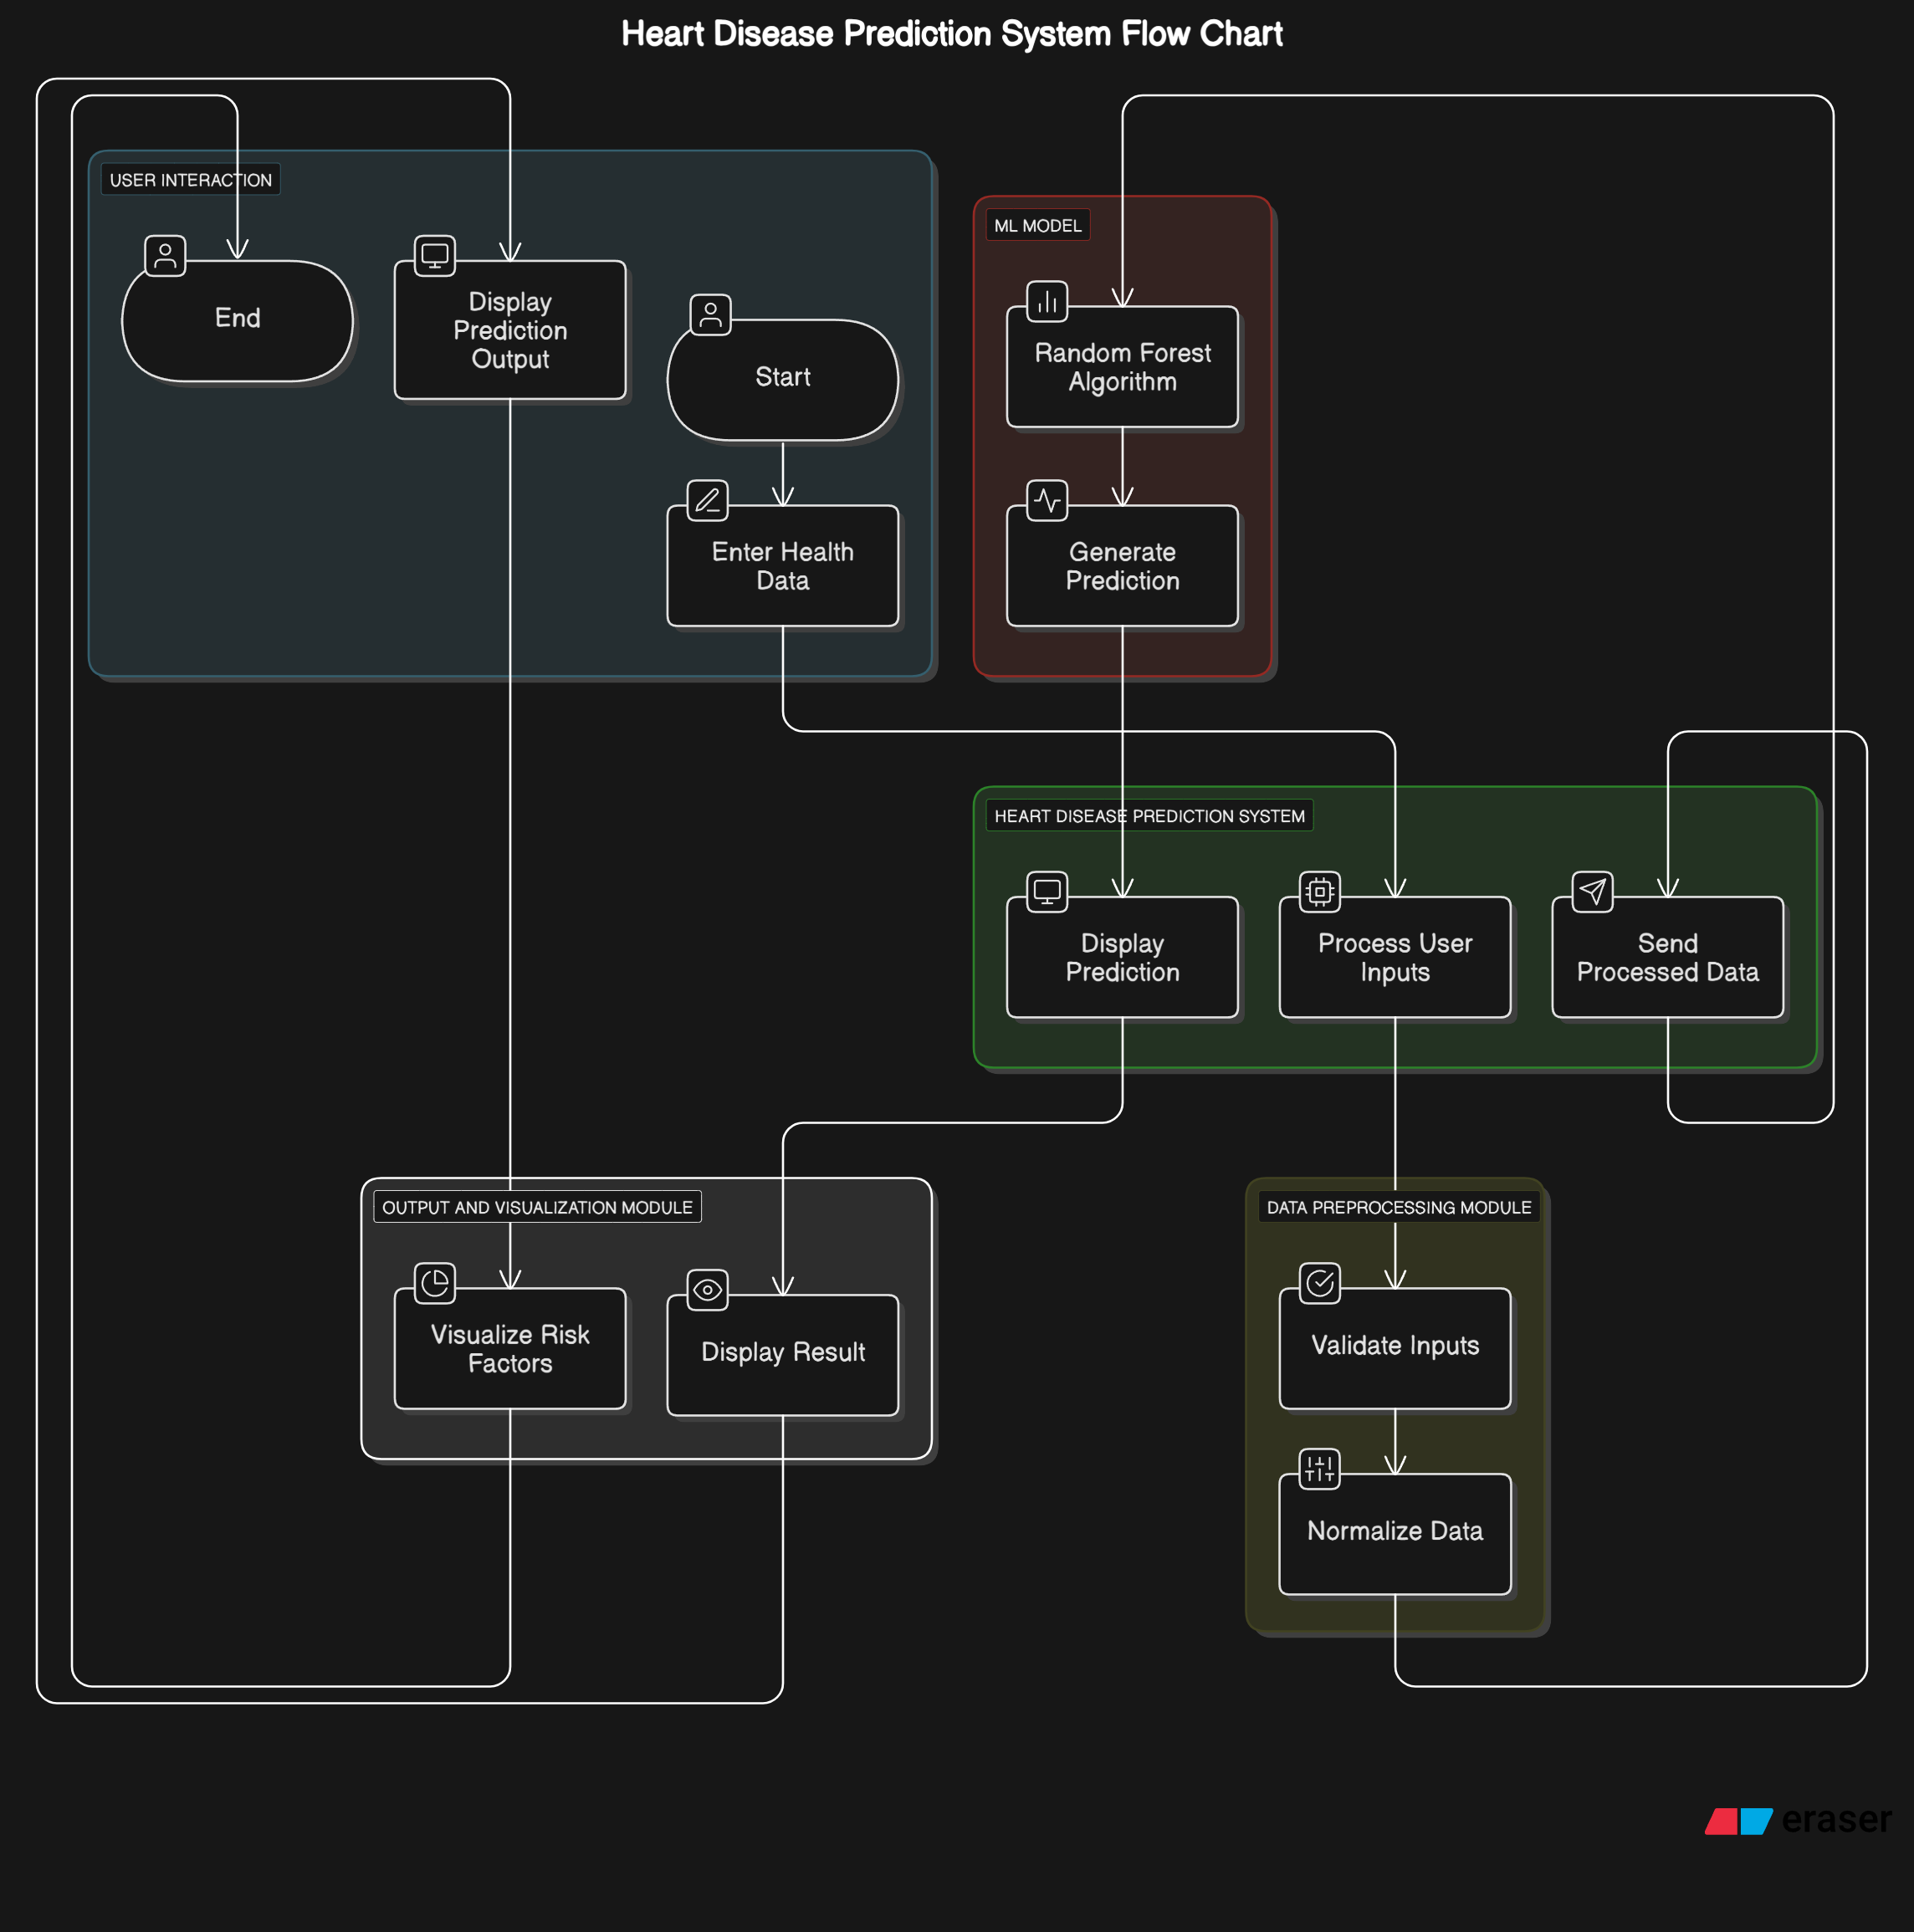
Data Flow Diagram:
Overall Data Flow:
User enters health data
Preprocessing module validates and normalizes inputs
Processed data is sent to the ML model
The ML model predicts heart disease risk
Prediction result is displayed to the user with possible visualizations

Slide 9
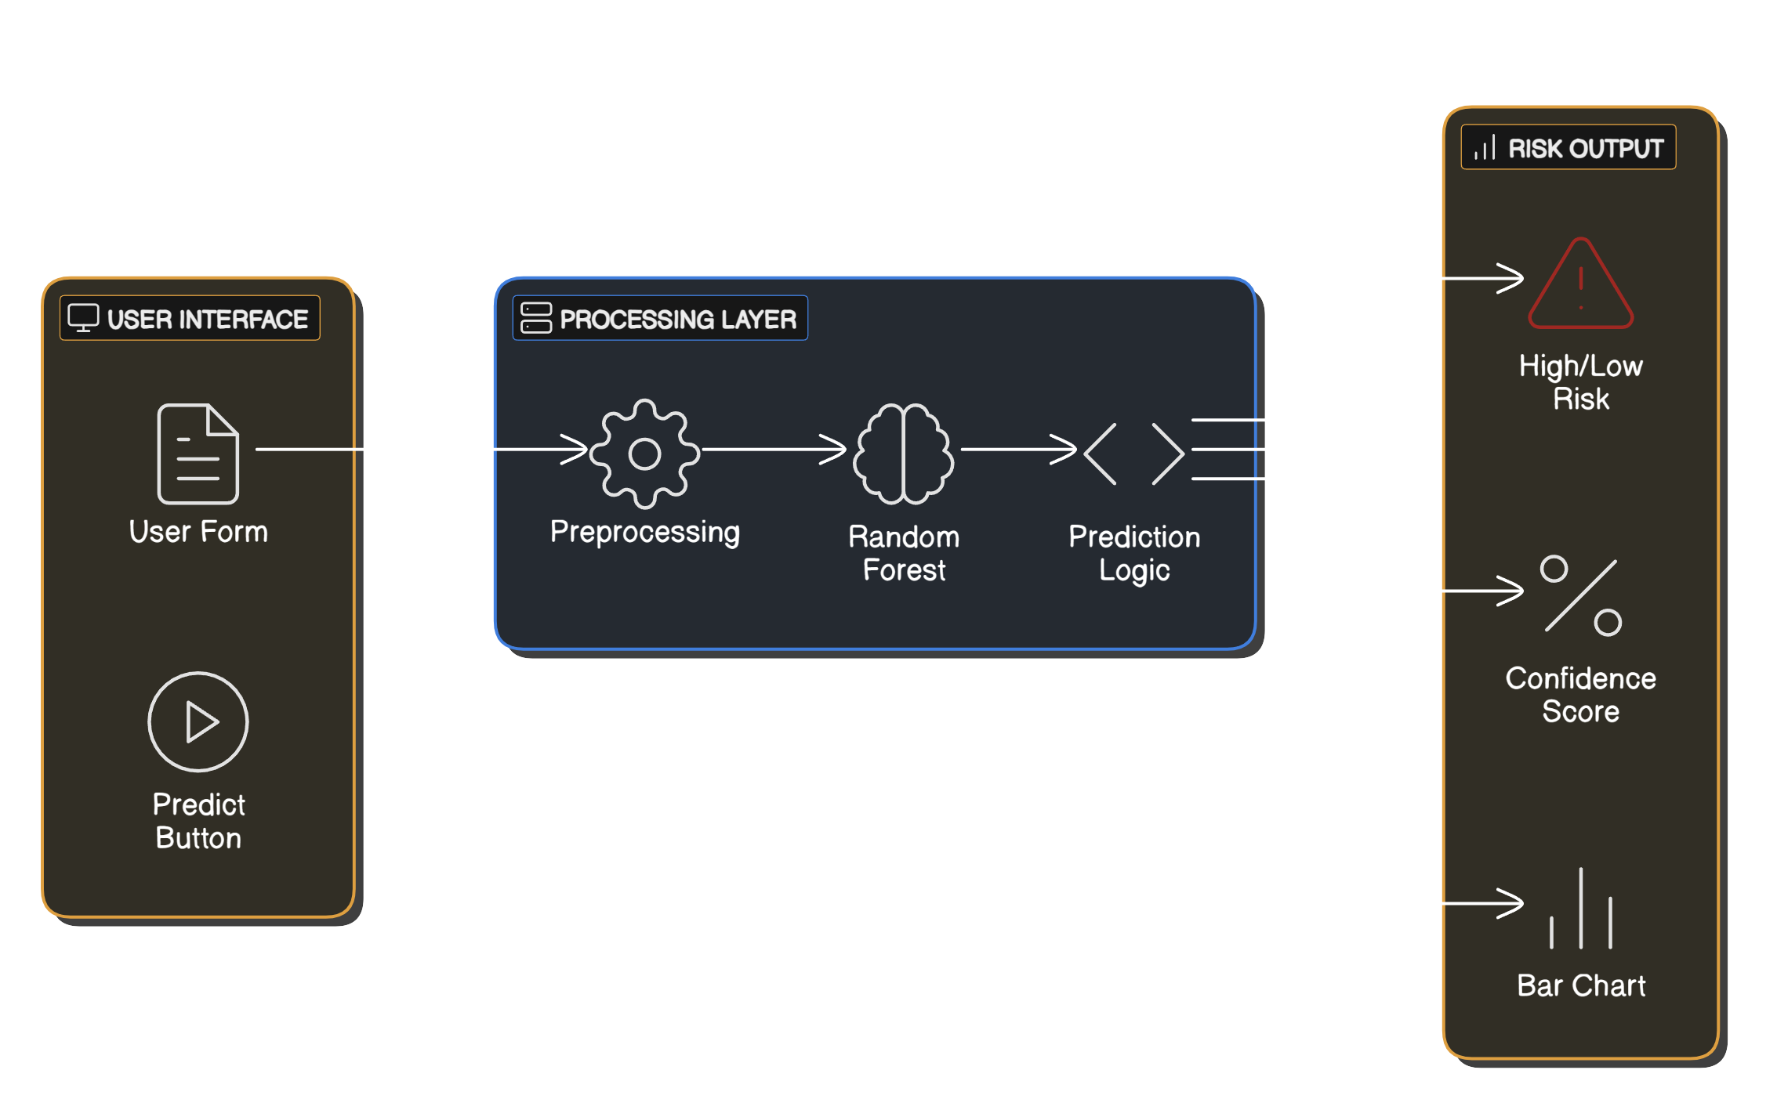
Architecture Diagram:
Key Components:
User Interface (UI)
User Form: Collects user health data.
Predict Button: Triggers the prediction process.
Processing Layer
Preprocessing: Cleans and normalizes input data.
Random Forest: The machine learning model making predictions.
Prediction Logic: Determines the final risk category.
Risk Output
High/Low Risk: Displays risk level.
Confidence Score: Shows model certainty.
Bar Chart: Visualizes contributing risk factors.

Slide 10
Source Code

Slide 11
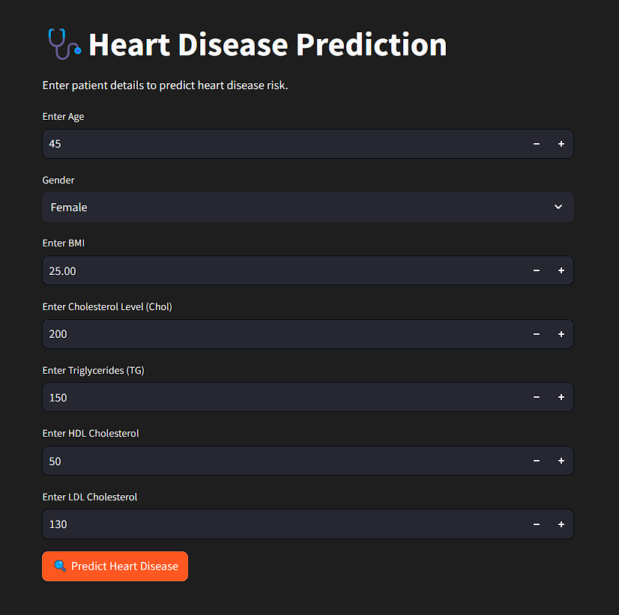
Output Screenshots:

Slide 12
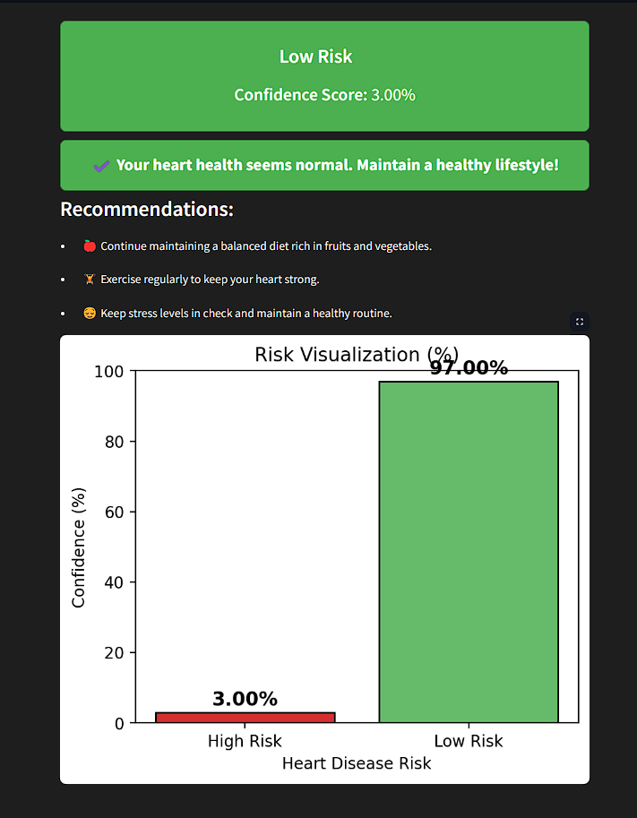
Output Screenshots:

Slide 13
System Testing:
FUNCTIONAL TESTING
🔹 User Input Form – Users can enter health parameters correctly. 🔹 Prediction Execution – Users can submit data and receive a prediction. 🔹 Result Display – Users can view prediction results (High/Low Risk) along with confidence scores.
SECURITY TESTING
🔹 Data Protection – User health data is securely processed and not stored permanently.
PERFORMANCE TESTING
🔹 Speed Test – Prediction should be generated within seconds. 🔹 Load Test – Application must handle multiple users simultaneously without lag.
USABILITY TESTING
🔹 Easy Navigation – User-friendly interface for inputting health data and viewing results. 🔹 Error Messages – Clear validation messages for incorrect inputs (e.g., out-of-range values).

Slide 14
Future Scope:
Database Integration: Store user inputs, predictions, and history for future reference.
Informational Section: Provide details about diseases, symptoms, and model usage within the app.
User Authentication: Implement login/signup for personalized tracking and data security.
Doctor Consultation Feature: Enable users to connect with healthcare professionals based on risk levels.
PDF Report Generation: Provide users with downloadable reports summarizing their health predictions.
User Feedback Mechanism: Collect feedback to improve model accuracy and user experience.

